Slide 1

Acceptance
Team Boomz

Slide 2
Agenda
Team Boomz
Project Overview
Features
Prototype Demo
Project Management
Development Process
Schedule
Risk & Mitigation
Learning Outcomes

Slide 3
Team Boomz
Lee Jun Kit
Lead Developer
Adrian Cheng
Testing Lead
Tommi Lew
Developer
Asti Andayani Temi
Project Manager
Tan Weijie
UI Developer

Slide 4
Project Manager
Develop project plan and schedule together with the team
Ensure that tasks are completed and the schedule is closely adhered to
Manage and keep track of team's performance throughout the project life cycle
Responsible for communication with supervisor, client and potential users (for UAT)

Slide 5
UI Developer
Design and develop User Interface
Responsible for UI development software exploration
Closely work with the developers for continuous integration effort
Assist in all project management responsibilities

Slide 6
Lead Developer
Lead the development team in developing features of the application
Responsible for development tools exploration and research
Work closely with the UI developer for continuous integration effort
Assist PM in ensuring that the development progress adheres to the schedule

Slide 7
Developer
Responsible for features development
Assist lead developer in exploring the development tools and research
Work closely with the UI developer for continuous integration effort
Responsible to work closely with the Testing Manager in order to ensure test ready application

Slide 8
Testing Lead
Assist PM in ensuring that testing is done according to schedule
Responsible for testing tools exploration and research
Responsible for testing data and test cases
Handling server setup and configurations

Slide 9
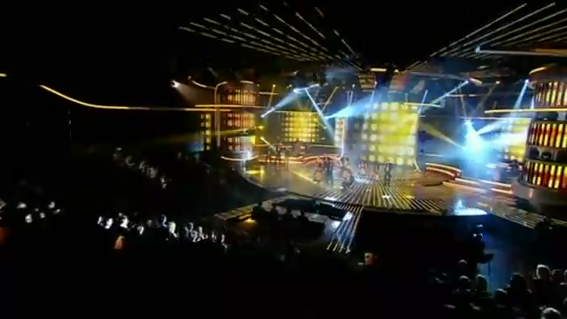
Mini Musical Star Project Overview

Slide 10
Mini Musical Star Project Overview - Features
Be in the musical
Replace vocal parts with your very own recording!
Enhance the song by adding your own photos!
Take advantage of the helper hints in the app to make the best musical!
Share
Show off your creativity right on your iPad!
Upload your musical on YouTube or Facebook!
Notes:
Do we want to do Dropbox?

Slide 11
Mini Musical Star Project Overview - Features
Purchase even more musicals
Use In-App Purchasing to get even more musicals to play with!
Create your own musical
Record your own musical video
Record your own cues for future users
Notes:
These are features among the 120% right?

Slide 12
Mini Musical Star Deliverables
A working iPad Application, with the following features completed and usable:
At least 2 musicals included in the iPad application
Users can re-record and replace the vocal tracks and replace photo templates with photos of themselves
Users can play back the musical with their edits in place
Users can export the musical and share it on Youtube and Facebook
This application will also be available on the Apple App Store.

Slide 13
Technical Risk Mitigation
Paper Prototype
June- July
#1 Milestone
Acceptance
May
August
Use Case
May
April
Project Adoption
April
August
Inception
Elaboration
April
Scoping
Scheduling
Powerpoint Prototype
May
June

Slide 14
#2 UAT #1
#4 UAT #2
September
Distribution
October
AppStore Deployment
September
#3 Mid-Term Presentation
Saving
#6 Final Presentation
October-November
August
September
November
August
November
Construction
Transition
Editing
Design/Usability Workshop
Purchased Musicals
#5 UAT #3
August
August
September
November

Slide 15
Development Process
Consists of 4 phases:
Inception
Elaboration
Construction
Transition
Construction and Transition phase: 9 2-week iterations from August to end-November
Each phase consists of features development along with automated testing
Following agile/scrum methodology within each iteration
Adherence to fixed milestones and deadlines
Schedule: Project Timeline.xlsx
Notes:
Questions by Jun Kit:
2 week iteration length for all 4 phases or for construction only? For construction only
If we are doing agile/scrum within each iteration is the project timeline/schedule really useful? Yes, it’s only milestone schedule
Need to *really emphasise* more on our development methodology – which components are fixed (our milestones and deadlines) and which are more fluid (our feature set for each iteration etc)
Mention that we are doing automated unit testing somewhere..?
How are we going to find bugs or track what things are bugs?

Slide 16
Development Process Frequently Asked Questions
If we are doing agile/scrum within each iteration is the project timeline/schedule really useful?
Yes. This project still requires us to adhere to certain fixed deadlines, eg: UAT, Mid-Term and Final Presentation, etc., hence the schedule will be our guideline to meet all these milestones.
Which parts of your process are fixed and which parts are fluid?
The phases and milestones (UAT, etc) are fixed, but the feature set is fluid. In other words, we will have a build suitable for UAT or Final Presentation, but the feature set of these builds are subject to change.

Slide 17
Stuff we are using?
Xcode 4 for development and unit testing
Pivotal Tracker for agile/scrum project management and bug tracking
Metrics provider as well
Git/Github for version control

Slide 18
Metrics
Velocity Metric
Bug Metric

Slide 19
Velocity Metric
Point Scales (generated from Pivotal Tracker)
Point is assigned to each feature/story in Pivotal Tracker
Linear (0, 1, 2, 3)
Assigning points based on relative difficulty of completing this particular feature, eg: amount of effort and time involved
Provides the ability to estimate how many features can be completed within one iteration, taking into account the difficulty level of each item
Notes:
Velocity > do more features
Velocity = good
Velocity < drop

Slide 20
Velocity Metric
Velocity Calculation
Each feature is assigned a certain number of points
Velocity = Number of points we manage to complete in one iteration
Based on the point assigned to each item, X points worth of items will be put in the Current log, where X is the initial velocity. Initial velocity can be set for Iteration 1, subsequently X is based on the previous iteration’s velocity.
Notes:
Velocity > do more features
Velocity = good
Velocity < drop

Slide 21
Velocity Metric
Velocity – Action Guidelines
Optimum Velocity = Number of planned features for this FYP / Number of Iterations
Velocity | Actions Taken
Actual > Optimum | Aim to complete 120% by doing more features that initially do not belong to the prioritized list
Actual = Optimum | Aim to complete all features listed as prioritized by end of FYP
Actual < Optimum | Some features that are less prioritized will not be completed within FYP time frame – this has been communicated with the Client
Notes:
Velocity calculation on Pivotal Tracker = Average of 1 Iteration
Based on points assigned to each item, X points worth of items will be put in the Current log, where X is the initial velocity. Initial velocity can be set for Iteration 1, subsequently X is based on the previous iteration’s velocity.
Number features / number iterations → target velocity
100% on pivotal tracker:
Aim to finish these features by end of fyp
Taking
120% only when velocity is higher
Less < optimum communicated with clients about which features will not be done should this happen

Slide 22
Bug Metric Bug Severity Guidelines
Point | Description
1 | Low Impact Minor bugs like spelling errors and small user interface alignment issues that do not affect the execution of any use case. Unimportant.
2 | High Impact The system runs. However, some non-critical functionalities are not working. Bugs that involve logic.
3 | Critical Impact Bugs that cause the entire application to be down and not usable after a short period of time. We have to fix the bugs to continue.
Notes:
Metrics: 3, 2, 1
As long as there is a 3-point bug we stop development
As long as there is the 3rd 2-point bug we stop development
Two 2-point bugs concurrent
1-point bug fix as we go along

Slide 23
Bug Metric Bug Fix – Development Impact
Condition | Action
As long as there is a 3-point bug | Stop current development and fix bugs immediately.
As long as there are more than two 2-point bugs | Stop current development and fix bugs immediately.
Maximum of two 2-point bugs with no 3-point bug found | Bug fixing is done concurrently with the development.
Any number of 1-point bug(s) found | Development should not be disrupted, resume as usual. Fix bugs as we go along.

Slide 24

Bug Metric Bug Log
Run automated testing along with development
Log bug into Pivotal Tracker and assign point to it (refer to Bug Severity Guidelines)
At the end of each iteration, log all bugs found during this iteration, of these bugs, log those that have been fixed and log unfixed bugs which will be brought forward to the next iteration.

Slide 25
Bug Metric Bug Log

Slide 26
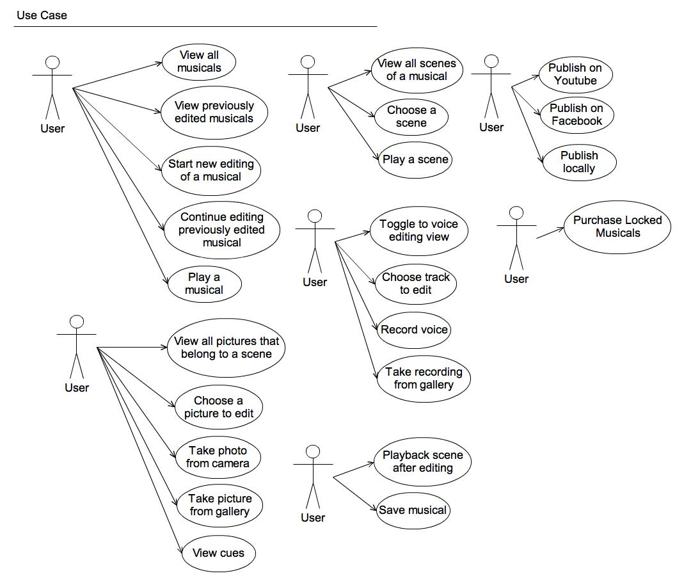
Use Case Diagram
Elaboration

Slide 27
Use Case Diagram
Elaboration

Slide 28
Use Case Diagram
Elaboration

Slide 29

Use Case Diagram
Elaboration

Slide 30
Use Case Diagram
Elaboration

Slide 31
Use Case Diagram
Elaboration
Notes:
What is “publish locally”? Is it saving and local playback? No, it’s render as movie and save the final render somewhere

Slide 32
Use Case Diagram
Elaboration
Notes:
Purchase locked musicals for in-app purchasing

Slide 33
Mini Musical Star Differentiating Factors
Comparison | Why our app is better for musical creation
vs Photo Booth | Cannot integrate photo “slideshow” with audio backing tracks. Cannot do backing track re-recording and replacing.
vs iMovie | These are general video editing programs. No specific functionality like backing track replacement, nor guides and hints for the user in musical creation. Our app provides a simple user interface for a specific purpose which these apps do not have.
vs Movie Maker
vs Garageband | No photo functionality. Requires an intermediate export to iMovie or similar for that.
vs iMovie + Garageband combo | Requires user to manually import in a pre-made musical template. No functionality for downloading new musical templates.

Slide 34
Technical Risk Mitigation
Elaboration
Use iOS library to merge 2 audio files
Play multiple audio tracks in sync
Record audio from microphone
Enable user to select the “part” that they would like to edit.
UI Gesture Recognition
Enable users to play back the musical with or without the part that they are replacing.
Unit Testing

Slide 35
Technical Risk Mitigation
Elaboration
IPAD DEMO

Slide 36
Risk & Mitigation
Risk | Severity | Likelihood | Mitigation
Scope Risk Scope/requirements specified by the Client might be misinterpreted by the team | High | Medium | Develop paper prototype during elaboration phase so as to ensure that both Client and team understand the requirements fully Scope is divided into smaller features
Team Risk Varied technical capabilities of each team member | Medium | High | Scope is divided into smaller features and assign features based on capabilities of each team member Sharing of knowledge within the team

Slide 37
Risk & Mitigation
Risk | Severity | Likelihood | Mitigation
Management Risk Most members had internship responsibility throughout Summer Difficulty in ensuring that all team members are aware of the overall status of the project | High Medium | High High | Agreed on the items need to be done and work was delegated accordingly Fixed meeting time at least once a week to update each other on project progress
Technical Risk Unfamiliarity with Objective-C/Cocoa Touch None has knowledge in iPad Application graphics design | High High | High High | Exploration and build working prototype during elaboration phase Engage professional designers to get feedback to enhance user experience

Slide 38
Learning Outcomes
# | Learning Outcomes
1 | Technical Skills Objective-C and C Python and Webapp2 Server Setup
2 | Project Management Skills Finding the metrics that can best reflect the team’s performance and progress of the project Time management as each member has different responsibility/schedule Mitigating as much risk as possible as throughout the project there might be unforeseen circumstances

Slide 39
Learning Outcomes
# | Learning Outcomes
3 | Working in a team Ability to leverage on individual’s strength Ability to manage each member’s expectation so as to align them to the team’s goals
4 | Communication skills 2-way communication with Client to ensure complete understanding of requirements from both parties
5 | E-Commerce Ability to identify opportunity for revenue generation

Slide 40
Q&A

Slide 41
Editing Functionalities August Week 2 - 3
Construction
Display editing page
Musicals are split into different scenes
Enable user to select the “part” that they would like to edit.
For a chosen musical scene, replace audio with an existing audio file

Slide 42
Editing Functionalities August Week 3 - 4
Construction
For a chosen musical scene, replace audio with an audio recording
For a chosen musical scene, replace video with an existing picture file
For a chosen musical scene, replace audio with a new picture taken from the app
Take photo

Slide 43
Editing Functionalities August Week 4 - 5
Construction
Enable users to play back the musical with or without the part that they are replacing.
Place the words on the screen as users are recording new audio parts.
UI Integration

Slide 44
Saving Functionalities August Week 5
Construction
Enable autosave function each time changes are made to the project and it will be saved as different version so that they can revert back to previous points in the process.

Slide 45
Saving Functionalities September Week 1
Construction
Provide some sort of major save function that will clean up past work in progress and reduce the storage needs on the iPad.
Enable users to play back the musical with their latest photos and audio recordings

Slide 46
Saving Functionalities September Week 2
Construction
Include the credits from the original musical at the end of each movie but replace the information for the part(s) that have been re-recorded with the users new information.

Slide 47
Distribution Functionalities September Week 3 – 5
Construction
Once all the audio or all the photos for a part has been completely replaced, enable the user to publish a new movie locally to their system.
Establish FB/Youtube link
Server Setup

Slide 48
iPad Deployment August - November
Transition

Slide 49
AppStore Deployment October Week 3 – November Week 3
Transition

